Slide 1
Nursing Vocabulary

Slide 2
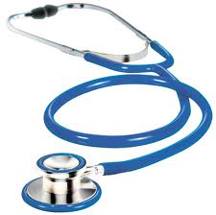
Stethoscope

Slide 3
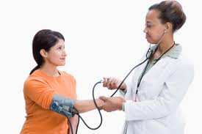
Blood Pressure

Slide 4
Nurse

Slide 5
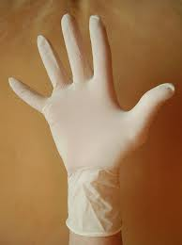
Gloves

Slide 6
Mask

Slide 7
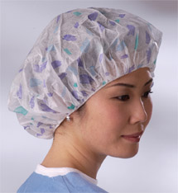
Surgical Cap

Slide 8
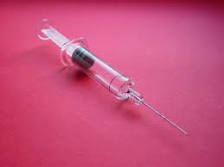
Needle

Slide 9
Scrubs

Slide 10
Hospital

Slide 11
Clinic

